Slide 1

Model Deployment in Python

Slide 2
Table of Contents
Brainstorming
What is Model Deployment
Types of model deployment
Common Model Deployments tools used in Python
Demo
Conclusion
References

Slide 3

Brainstorming
What is the problem?

Slide 4
What is Model Deployment?
It means integrating a machine learning model into an existing production environment, where it can take in an input and return an output

Slide 5
Three types of Model Deployment
One-off
Batch
Real Time

Slide 6
Batch Deployment
Allows you to
Update your model
Which is good for using the model in a continuous basis

Slide 7
Real Time Deployment
Allows you to
Have Instantaneous data training and prediction

Slide 8
Common Deployment Tools
Saving The Machine Learning Model as an Object using Pickel package in python.
Then apply the object on the new dataset
1
Embedding the ML model inside a web application Using Flask Package (Or Django, and Dash)
2

Slide 9
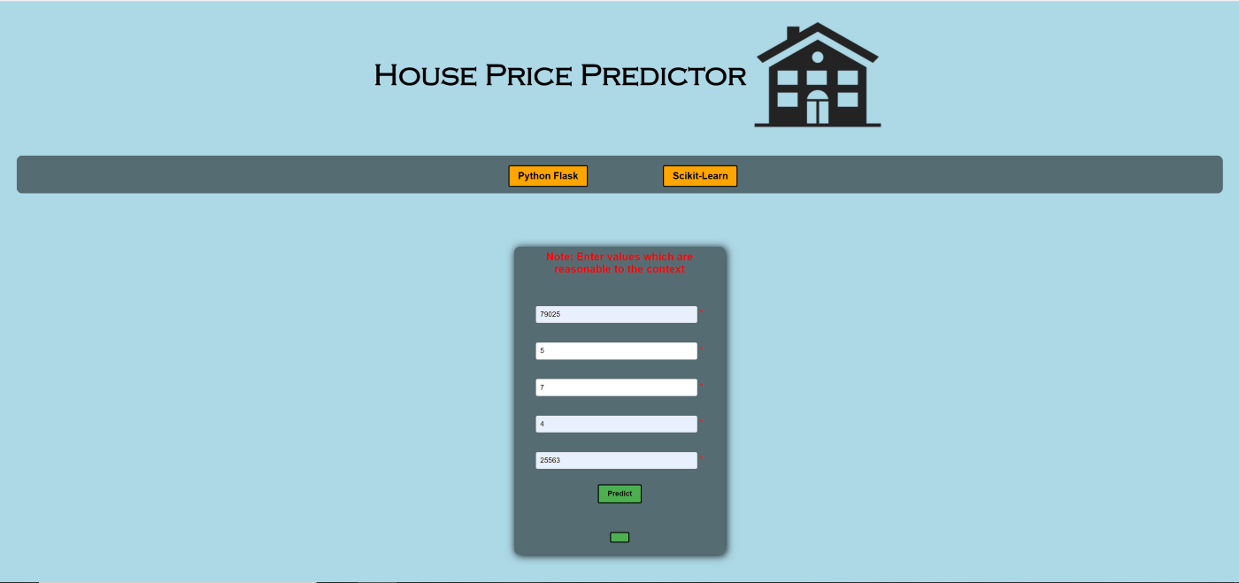
Model Deployment Using Flask

Slide 10

Demo

Slide 11
Conclusion

Slide 12
References
https://towardsdatascience.com/what-does-it-mean-to-deploy-a-machine-learning-model-dddb983ac416
https://towardsdatascience.com/deploying-machine-learning-models-into-a-website-using-flask-8582b7ce8802
https://www.youtube.com/watch?v=jMrp6XfYIyk
https://practicaldatascience.co.uk/machine-learning/how-to-save-and-load-machine-learning-models-using-pickle

